Slide 1
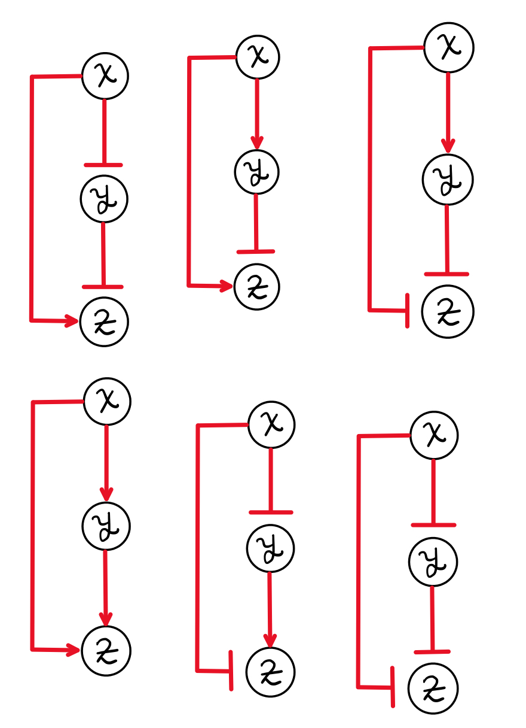
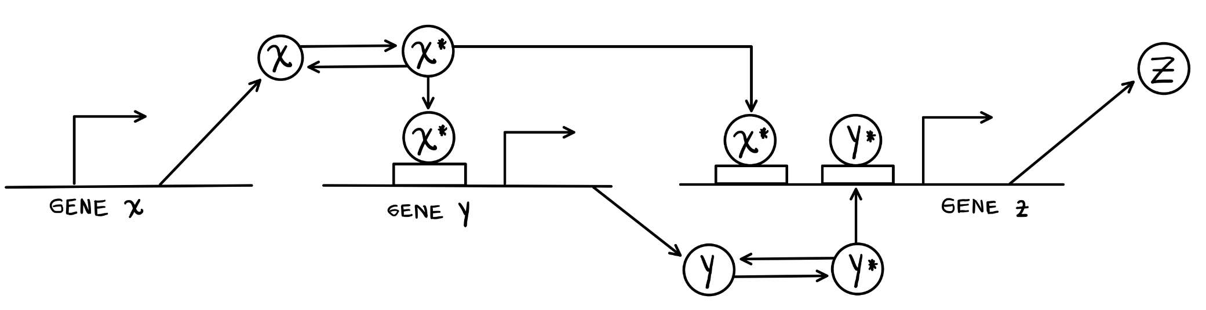

Health, mortality and Human Aging
Rafael Enrique Velásquez Rojas

Slide 2
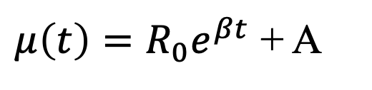
Gompertz Law to model the exponential increment
$μ\left(t\right)=R_{0}e^{βt}$ + A
Exponential model to explain the exponential increment of mortality with age
Sum of age dependent term and age independent term
Slide 3
Notes:
Some population there are described by high age independent death rates

Slide 3
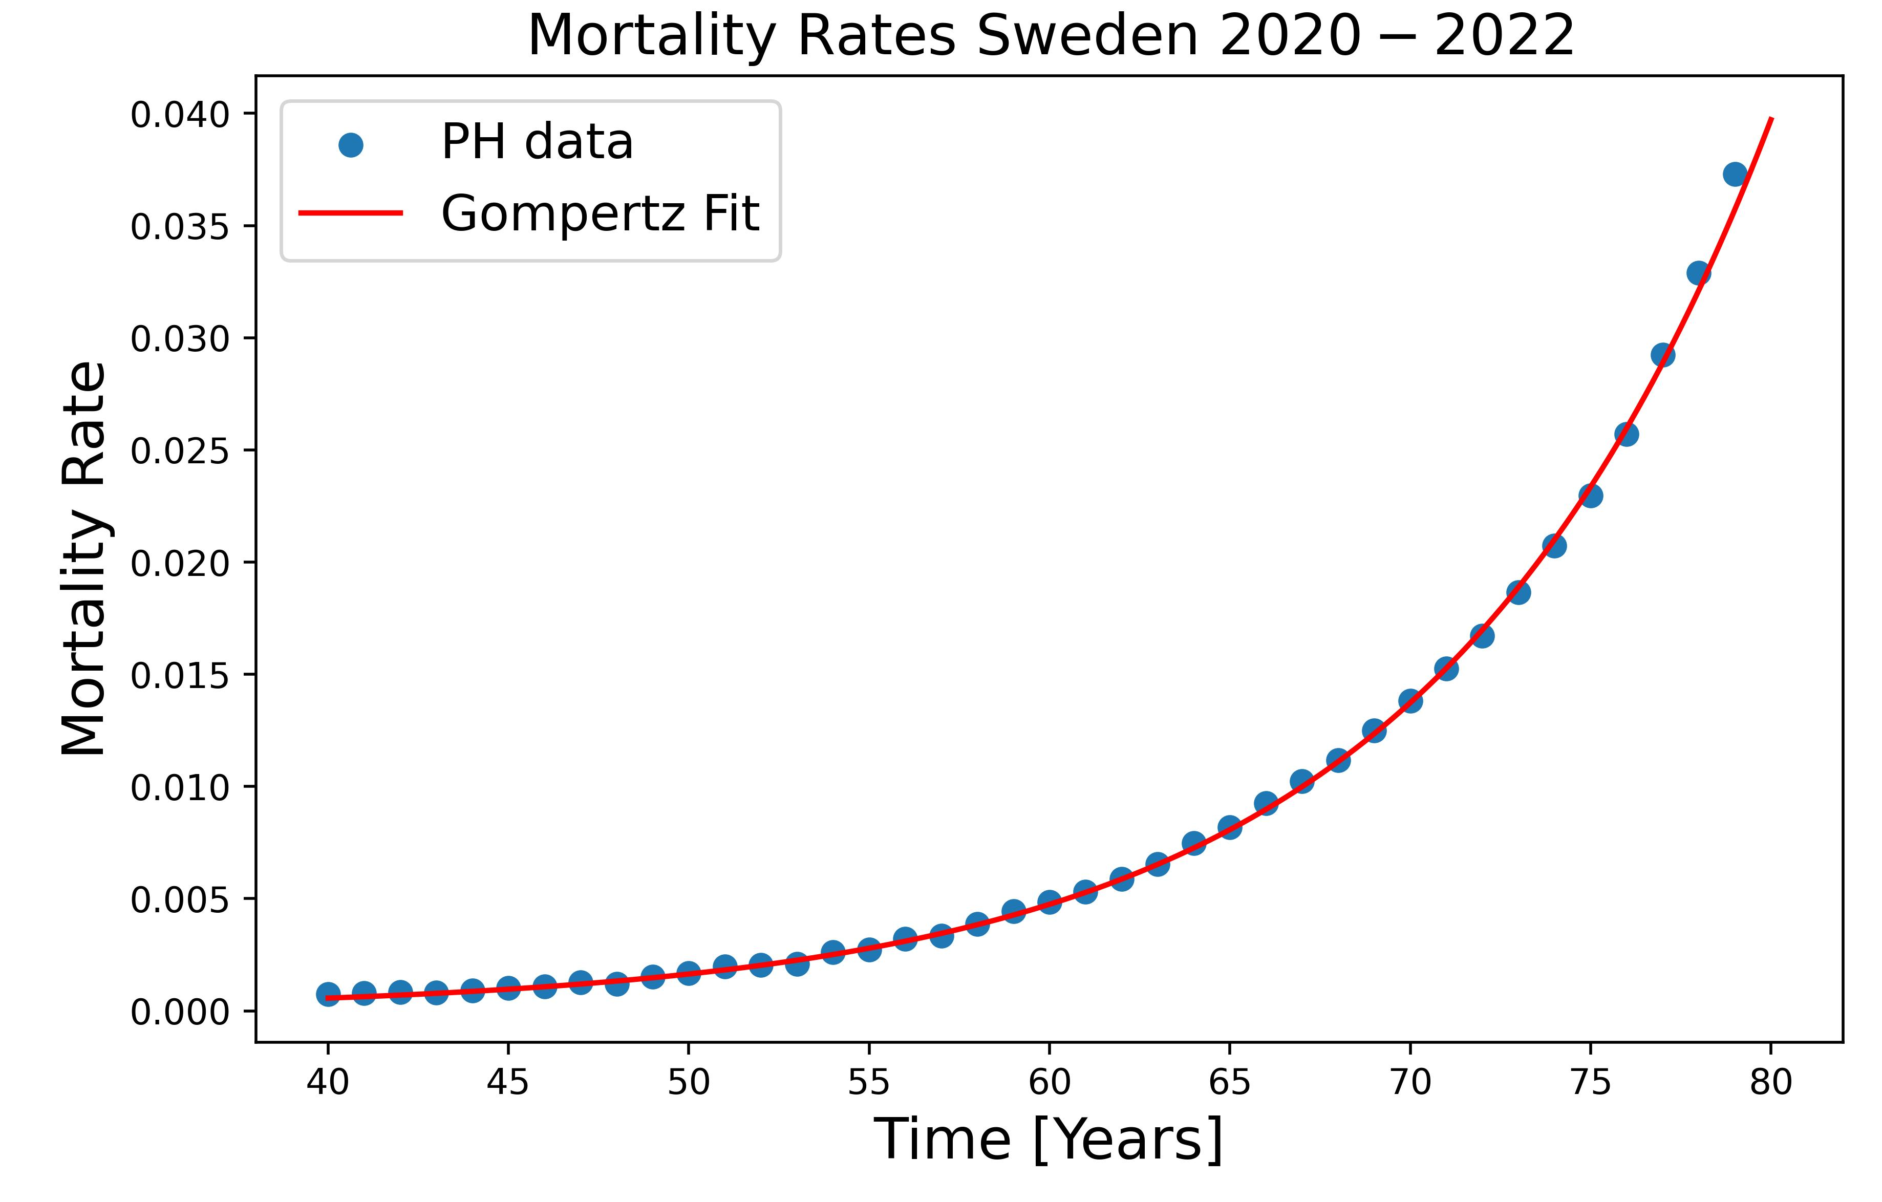
Gompertz Law to model the exponential increment
$μ\left(t\right)=R_{0}e^{βt}$ + A
Exponential model to explain the exponential increment of mortality with age
Sum of age dependent term and age independent term
Slide 3
Notes:
Some population there are described by high age independent death rates

Slide 4
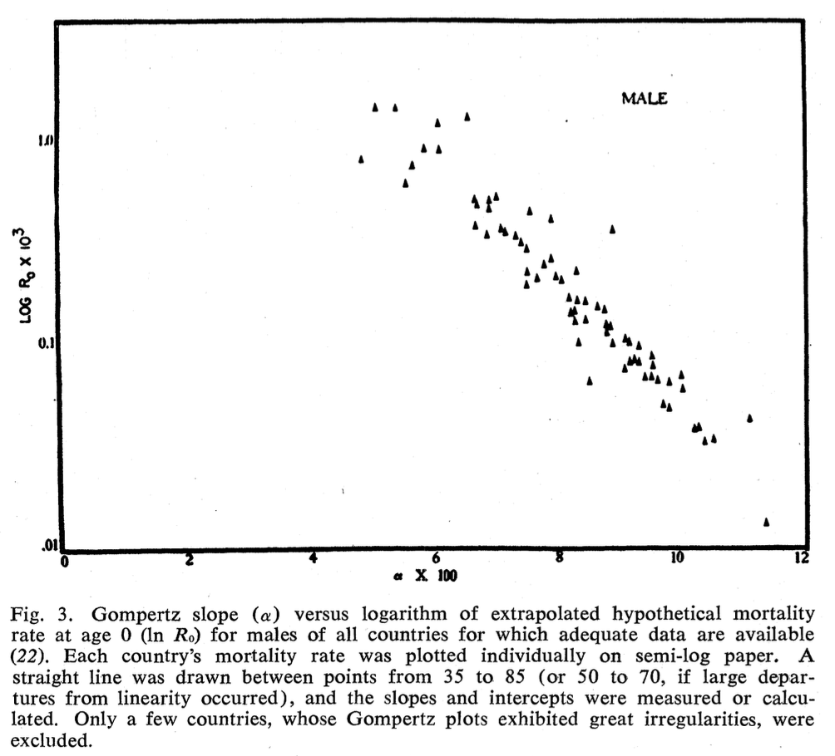
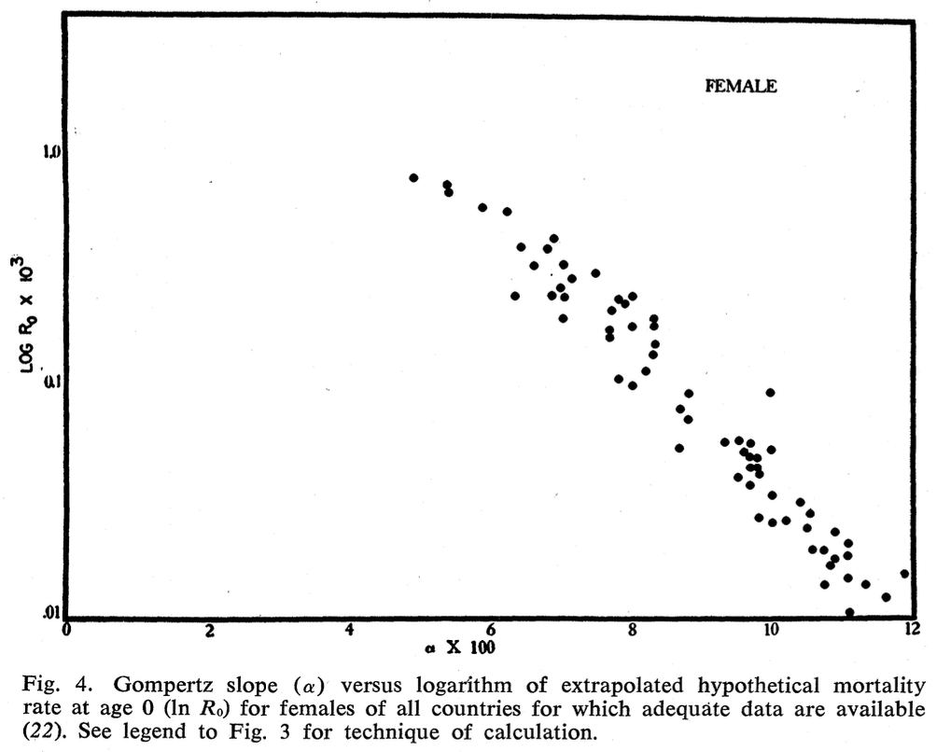
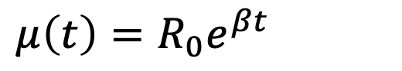
Gompertz Law to model the exponential increment
$μ\left(t\right)=R_{0}e^{βt}$
Gompertz Law exponential mortality
Slide 4
Notes:
Some population there are described by high age independent death rates

Slide 5
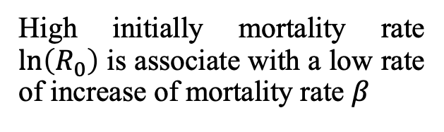
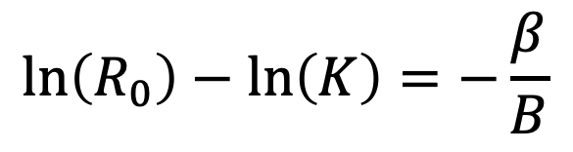
Strehler-Mildvan Correlation
$μ\left(t\right)=R_{0}e^{βt}$
Gompertz Law exponential mortality
$$\ln\left(R_{0}\right)−\ln\left(K\right)=−\frac{β}{B}$$
Correlation between two parameters of Gompertz Law
High initially mortality rate $\ln\left(R_{0}\right)$ is associate with a low rate of increase of mortality rate $β$
Slide 4
Notes:
Some population there are described by high age independent death rates

Slide 6
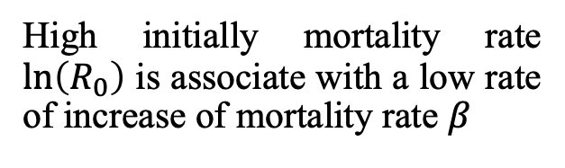
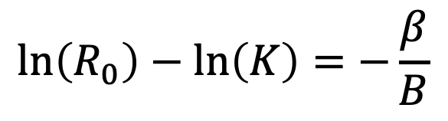
Strehler-Mildvan Correlation
$$\ln\left(R_{0}\right)−\ln\left(K\right)=−\frac{β}{B}$$
High initially mortality rate $\ln\left(R_{0}\right)$ is associate with a low rate of increase of mortality rate $β$
Slide 4
Notes:
Some population there are described by high age independent death rates

Slide 7
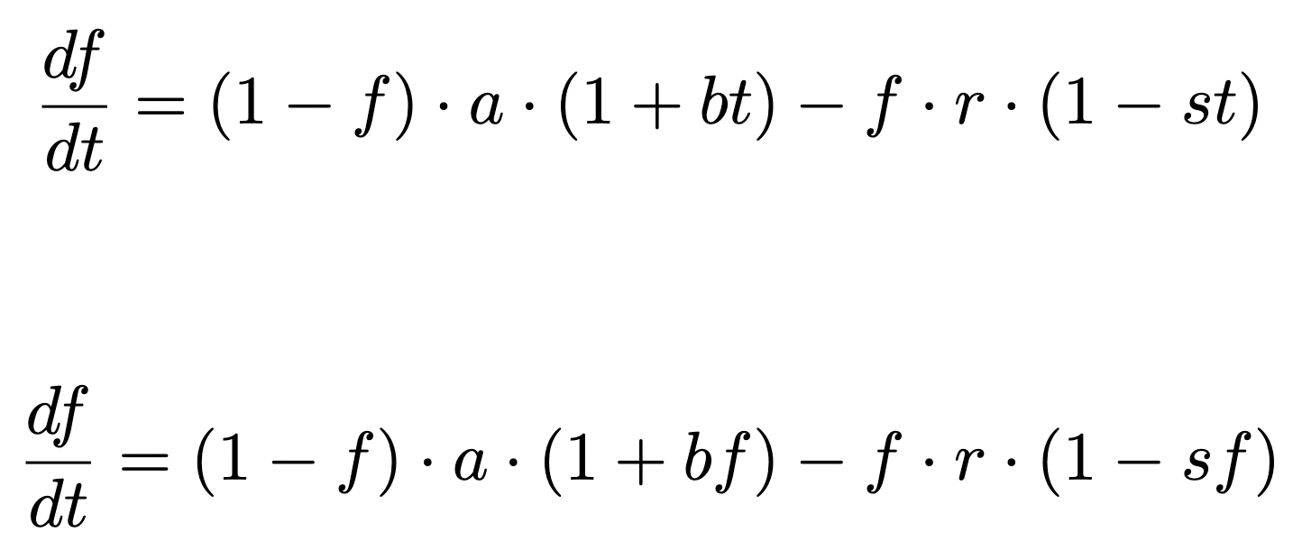
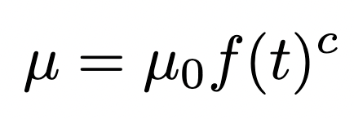
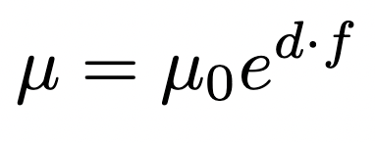
Developing a model for frailty index and mortality
Option 1 for frailty index model
Option 2 for frailty index model
Option 1 for mortality rate model
Option 2 for mortality rate model
Slide 8
Notes:
Some population there are described by high age independent death rates

Slide 8
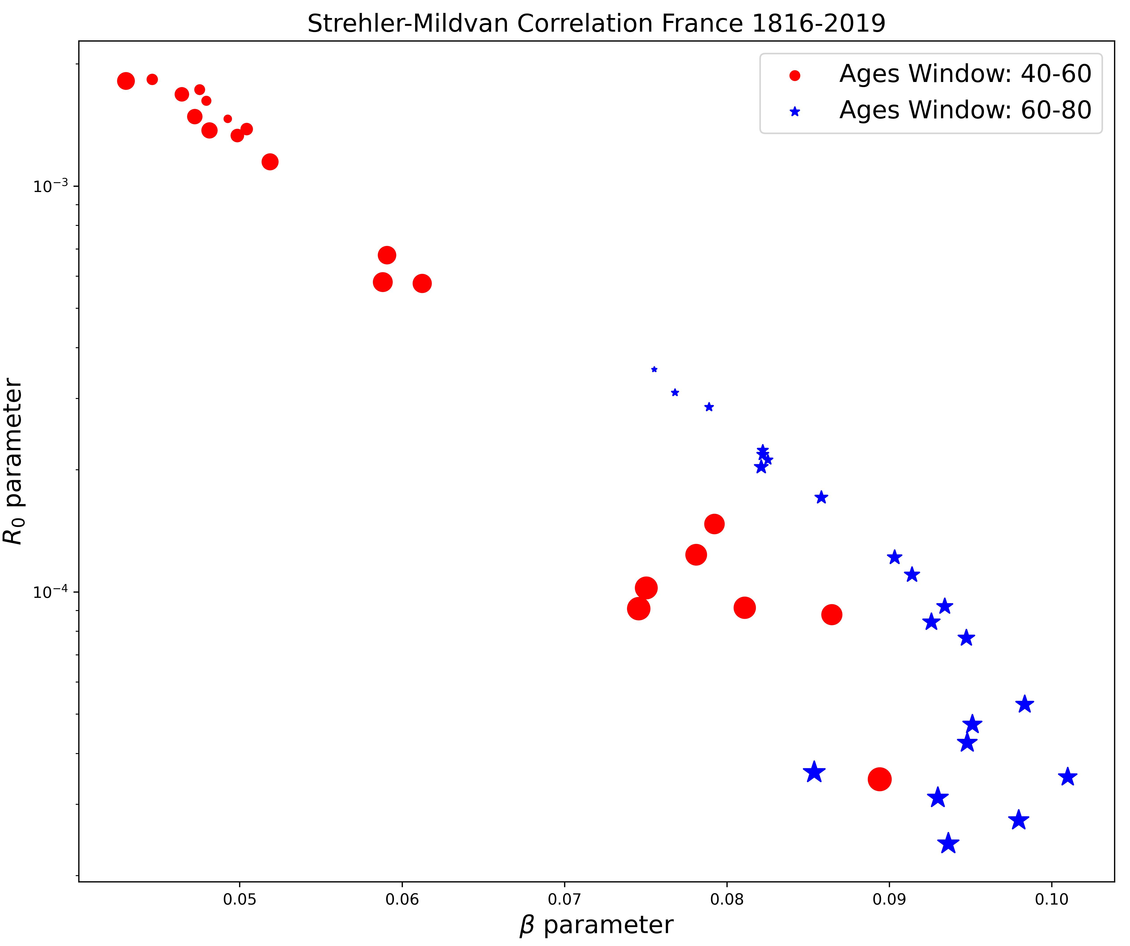
Strehler-Mildvan Correlation phenomenological data
Slide 9

Slide 9
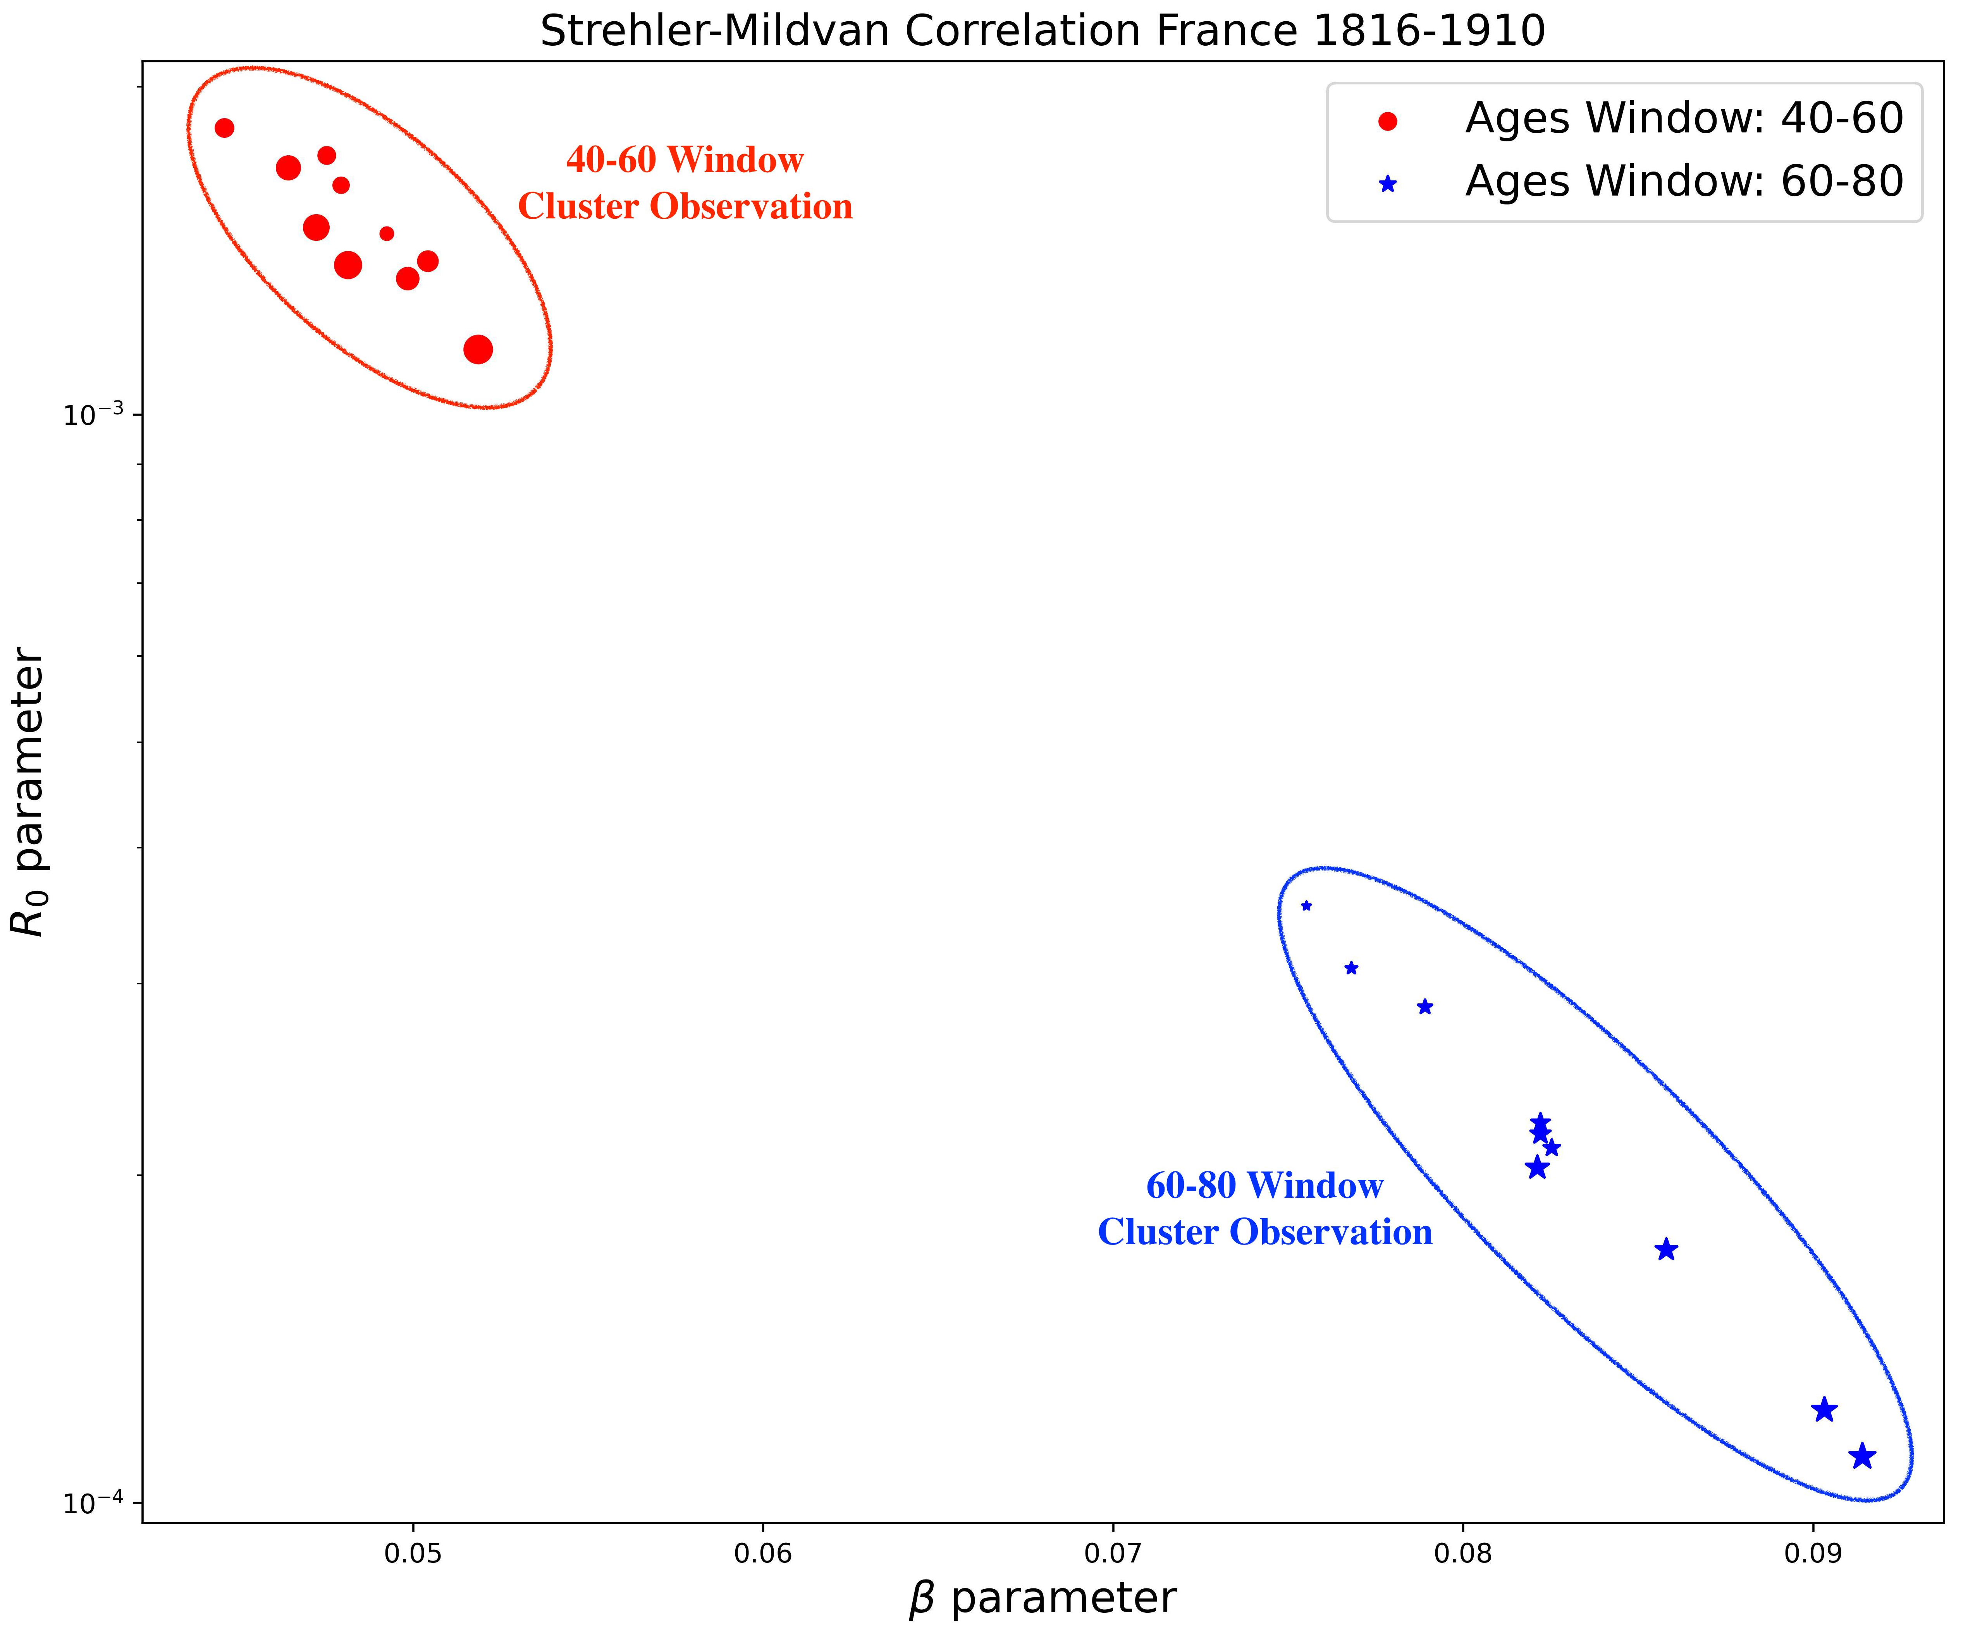
Strehler-Mildvan Correlation phenomenological data
Slide 9

Slide 10
Strehler-Mildvan Correlation phenomenological data
Slide 10

Slide 11
Strehler-Mildvan Correlation phenomenological data
Slide 10

Slide 12
Strehler-Mildvan Correlation phenomenological data
Differences in the correlation between the 40-60 window and the 60-80 window ages.
Slide 10

Slide 13
Strehler-Mildvan Correlation phenomenological data
Differences in the correlation between the 40-60 window and the 60-80 window ages.
Depending on the observation window, there are different values for the parameters of Gompertz’s Law.
Slide 10

Slide 14
Why these proposals for the models?
Slide XXX

Slide 15
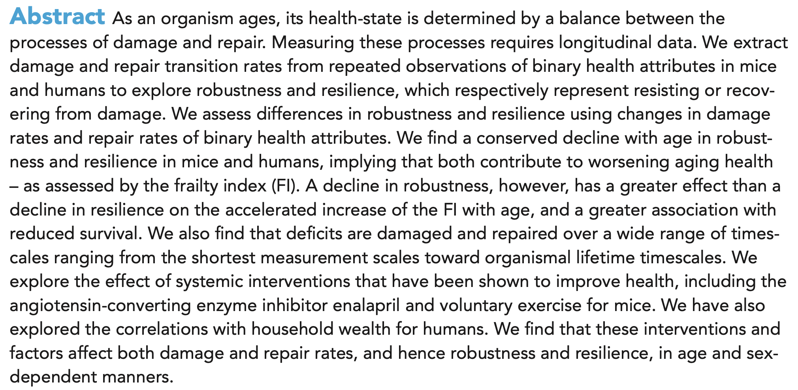
Why these proposals for the models?
Farrell, S., Kane, A. E., Bisset, E., Howlett, S. E., & Rutenberg, A. D. (2022). Measurements of damage and repair of binary health attributes in aging mice and humans reveal that robustness and resilience decrease with age, operate over broad timescales, and are affected differently by interventions. Elife, 11, e77632.
Slide XXX

Slide 16
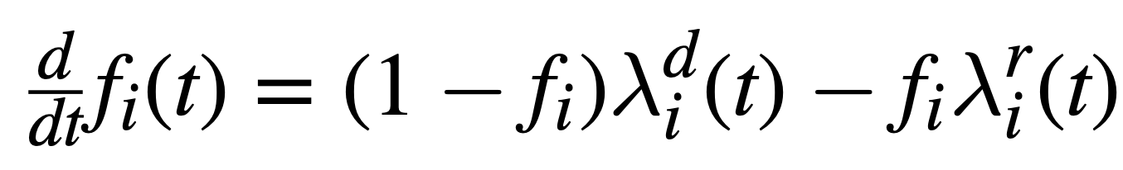
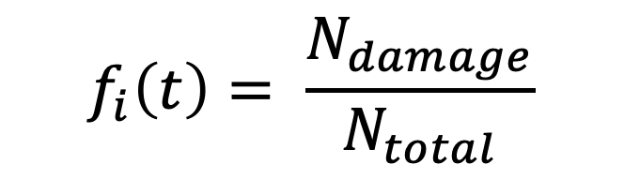


Repair and damages nodes model
$$f_{i}\left(t\right)= \frac{N_{damage}}{N_{total}}$$
$${(1−f}_{i})≝attributes available for damage$$
$$f_{i} ≝attributes available for repair$$
Slide XXX

Slide 17


Connection with our proposed model
Slide 8
Notes:
Some population there are described by high age independent death rates

Slide 18
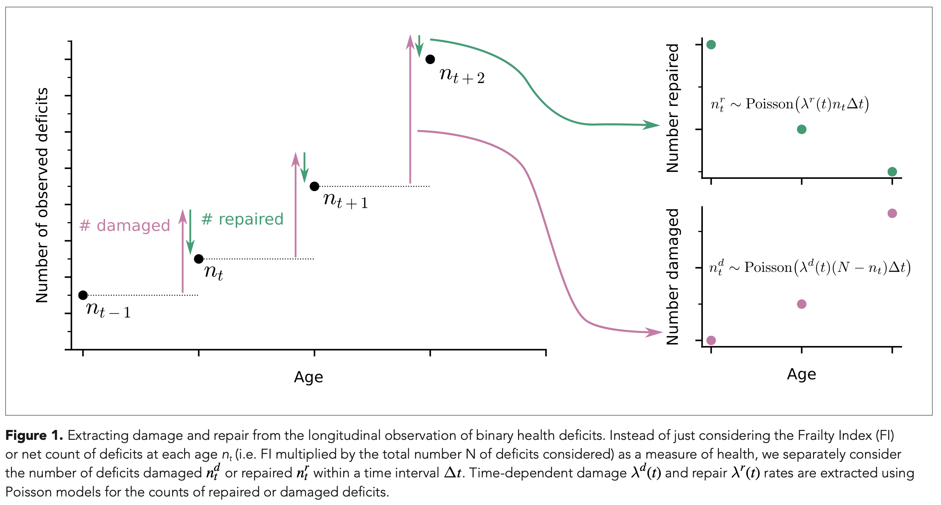
Number of Repaired and Damage Nodes
Slide XXX

Slide 19
Number of Repaired and Damage Nodes
This is the behavior of the repair and damage rates that we need to obtain the desired behavior for the model.
Slide XXX

Slide 20
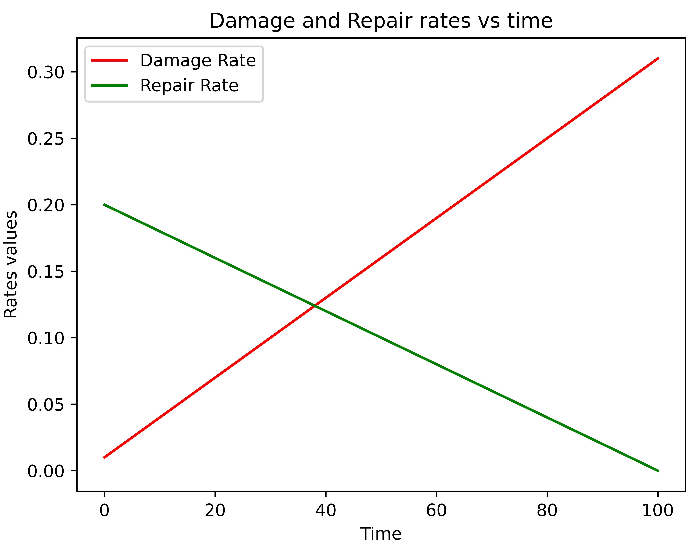
Number of Repaired and Damage Nodes
This is the behavior of the repair and damage rates that we need to obtain the desired behavior for the model.
Slide XXX

Slide 21
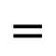
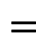
Number of Repaired and Damage Nodes
$$=$$
Damage rate function
$$=$$
Repair rate function
This is the behavior of the repair and damage rates that we need to obtain the desired behavior for the model.
Slide XXX

Slide 22
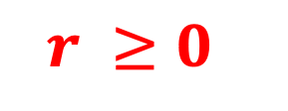
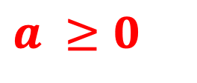
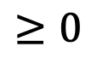
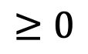
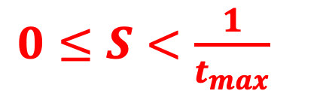
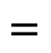
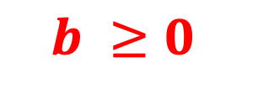
Guesses for the parameters
1) Both the repair and damage rate must be positive for all times.
$$=$$
$$≥0$$
$$=$$
$$≥0$$
$$a ≥0$$
$$b ≥0$$
$$r ≥0$$
$0≤S<\frac{1}{t_{max}}$
Slide XXX

Slide 23
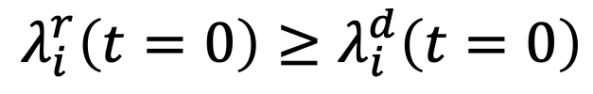


Guesses for the parameters
2) The rate of repair should be greater than the rate of damage at the onset of age.
At least a t = 0
Why?
$$λ_{i}^{r}\left(t=0\right)≥λ_{i}^{d}\left(t=0\right)$$
$$≥$$
$$r ≥a$$
Slide XXX

Slide 24

Guesses for the parameters
2) The rate of repair should be greater than the rate of damage at the onset of age.
At least a t = 0
Why?
$$r ≥a$$
Slide XXX

Slide 25
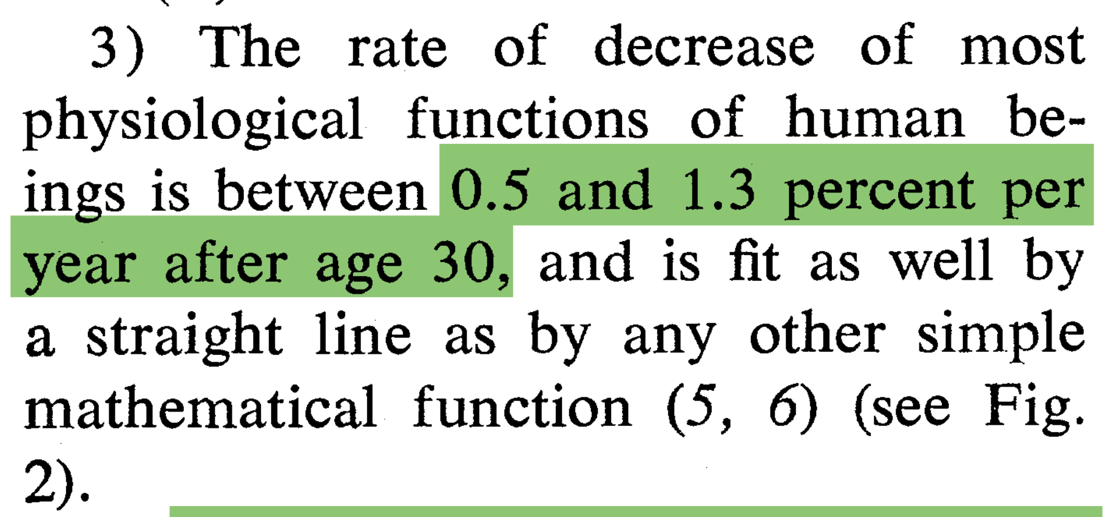
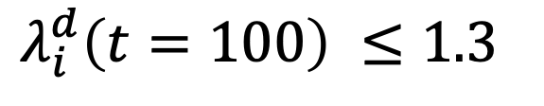
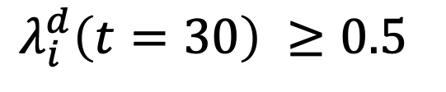
Guesses for the parameters
3) The rate of decrease of most physiological functions of humans beings is between 0.5 and 1.3 percent per year (???).
$$λ_{i}^{d}\left(t=30\right) ≥0.5$$
$$λ_{i}^{d}\left(t=100\right) ≤1.3$$
Slide XXX

Slide 26
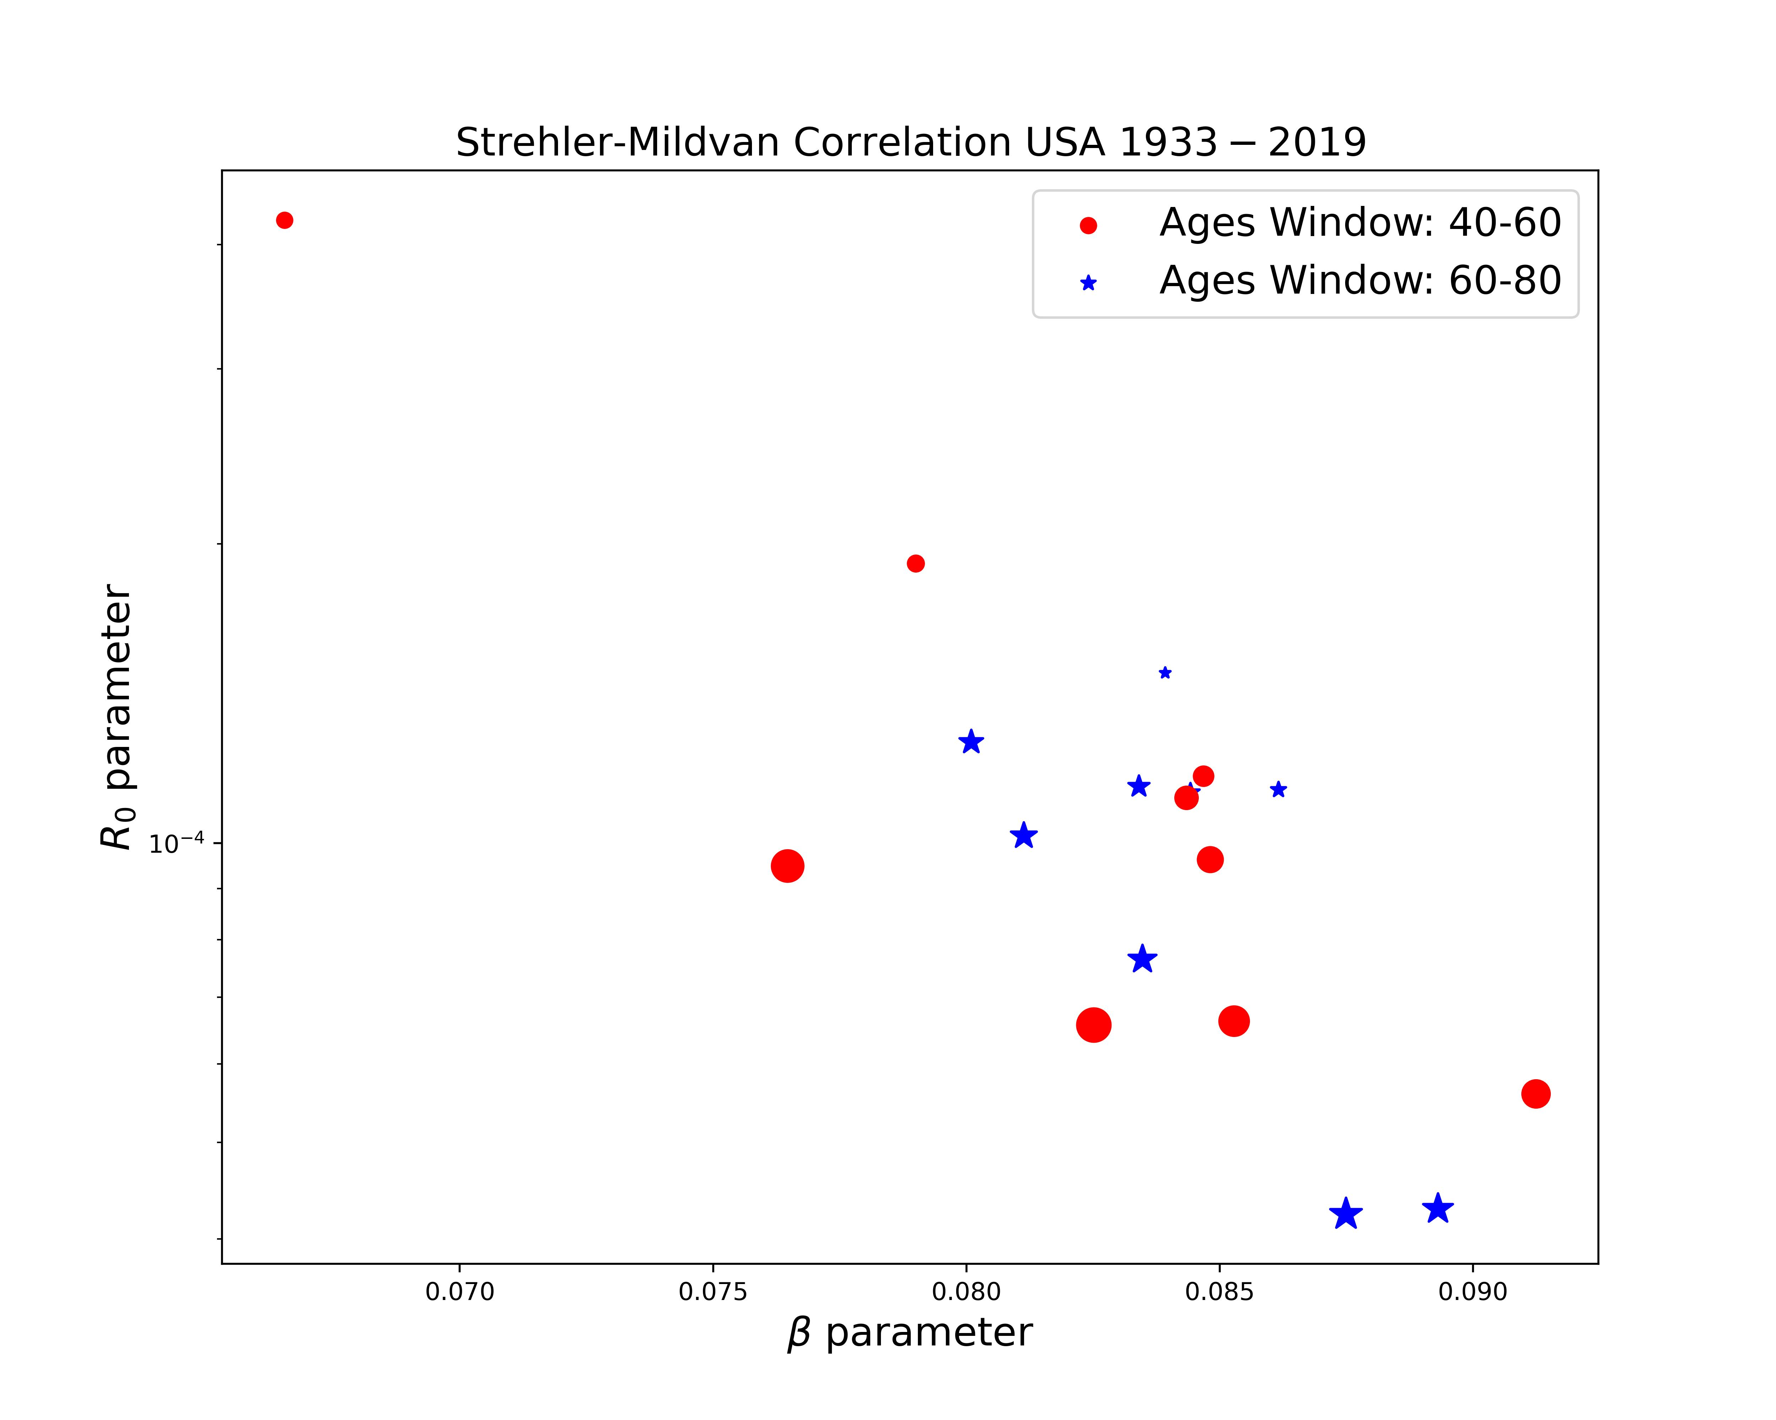

SM correlation is not a strong result

Slide 27
SM correlation is not a strong result
Here we will put results from phenomenological data that shows that Strehler-Mildvan Correlation is not a strong results.
The reason why we cant see the SM correlation as in the paper of 1960 is because:
Gompertz Slope (alpha) could change in the time
Ro could change in the time
Therefore, the correlation between this two values could be dynamic in time and not just one point for the entire curve of mortality rate.
Slide XXX

Slide 28
SM correlation is not a strong result

Slide 29
SM correlation is not a strong result

Slide 30
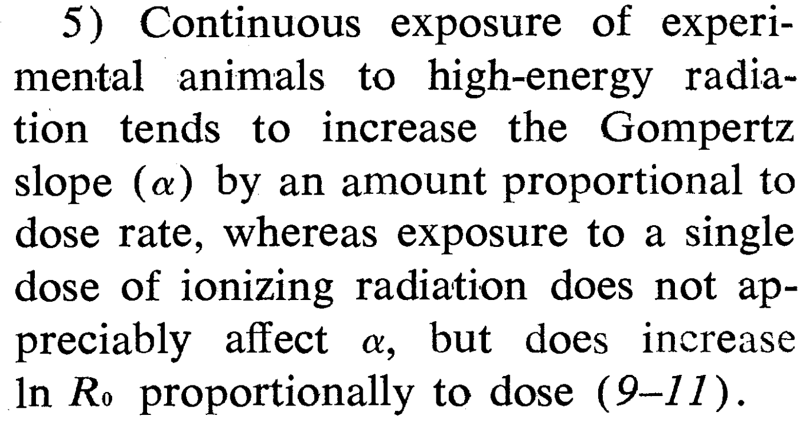



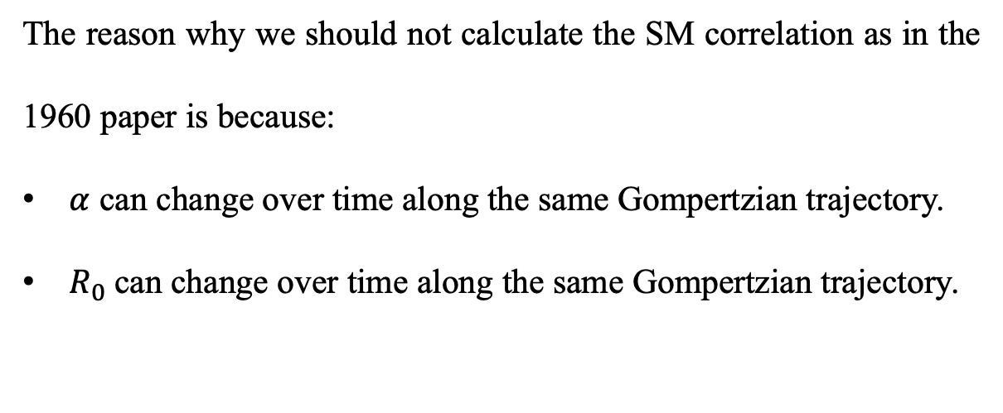




SM correlation is not a strong result (???)
The reason why we should not calculate the SM correlation as in the 1960 paper is because:
$α$ can change over time along the same Gompertzian trajectory.
$R_{0}$can change over time along the same Gompertzian trajectory.
Slide XXX

Slide 31
Model results for SM correlation
Slide XXX

Slide 32
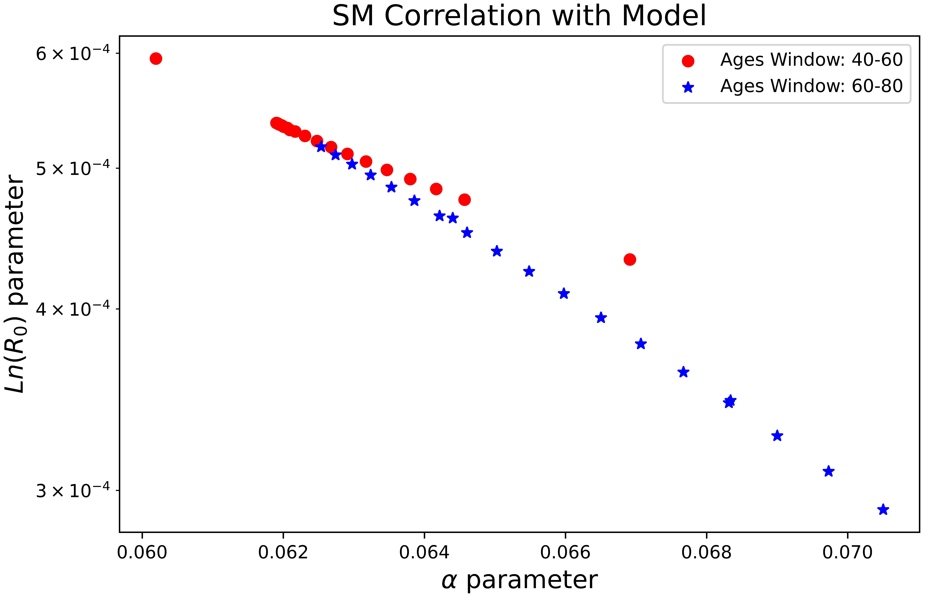
Model results for SM correlation
Slide XXX

Slide 33
Model results for SM correlation
Slide XXX

Slide 34
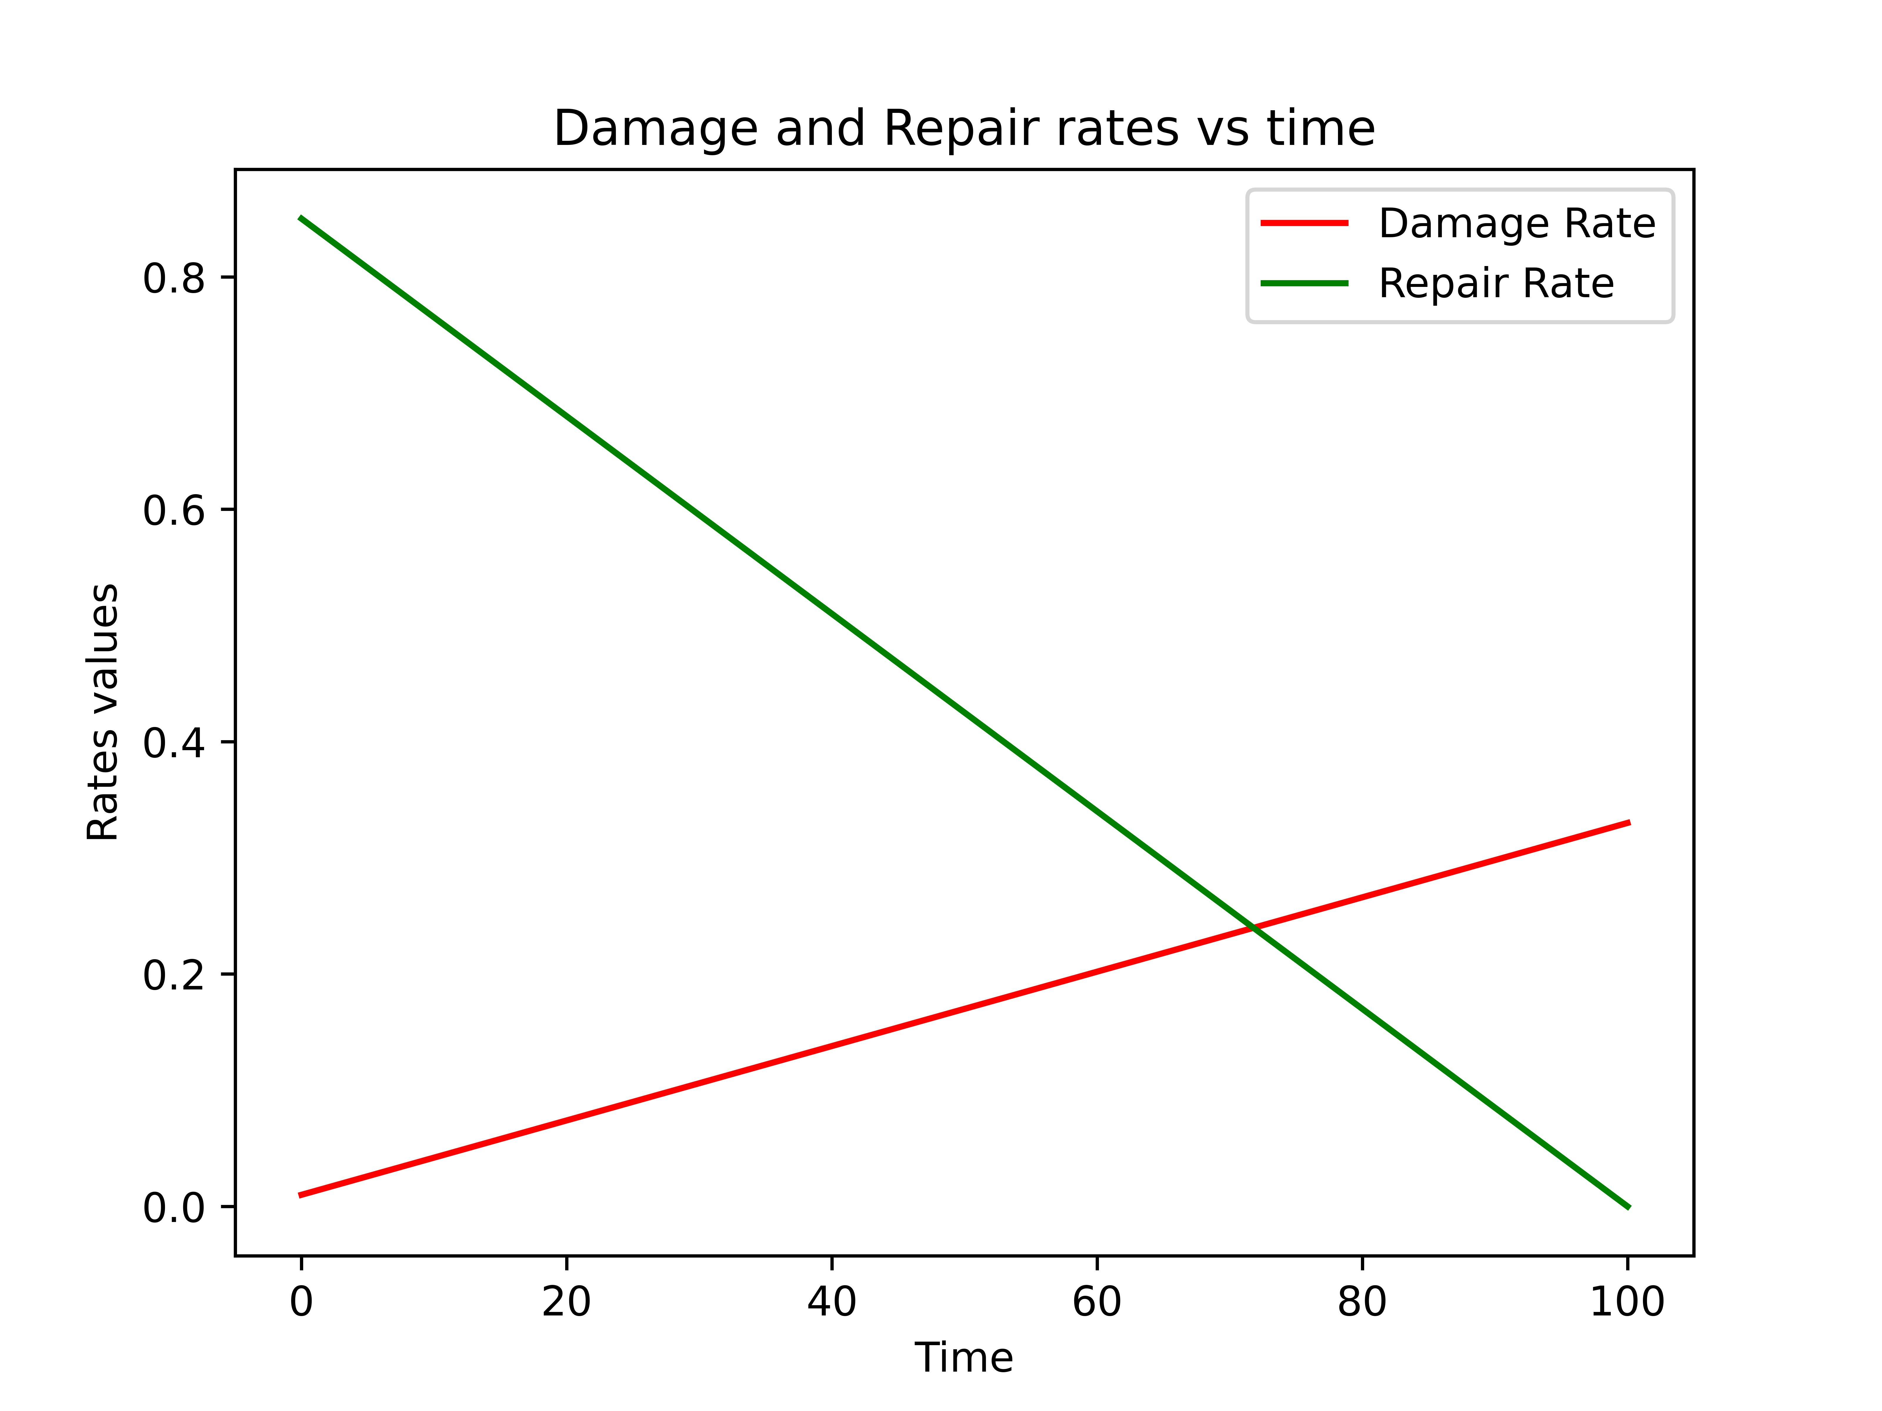
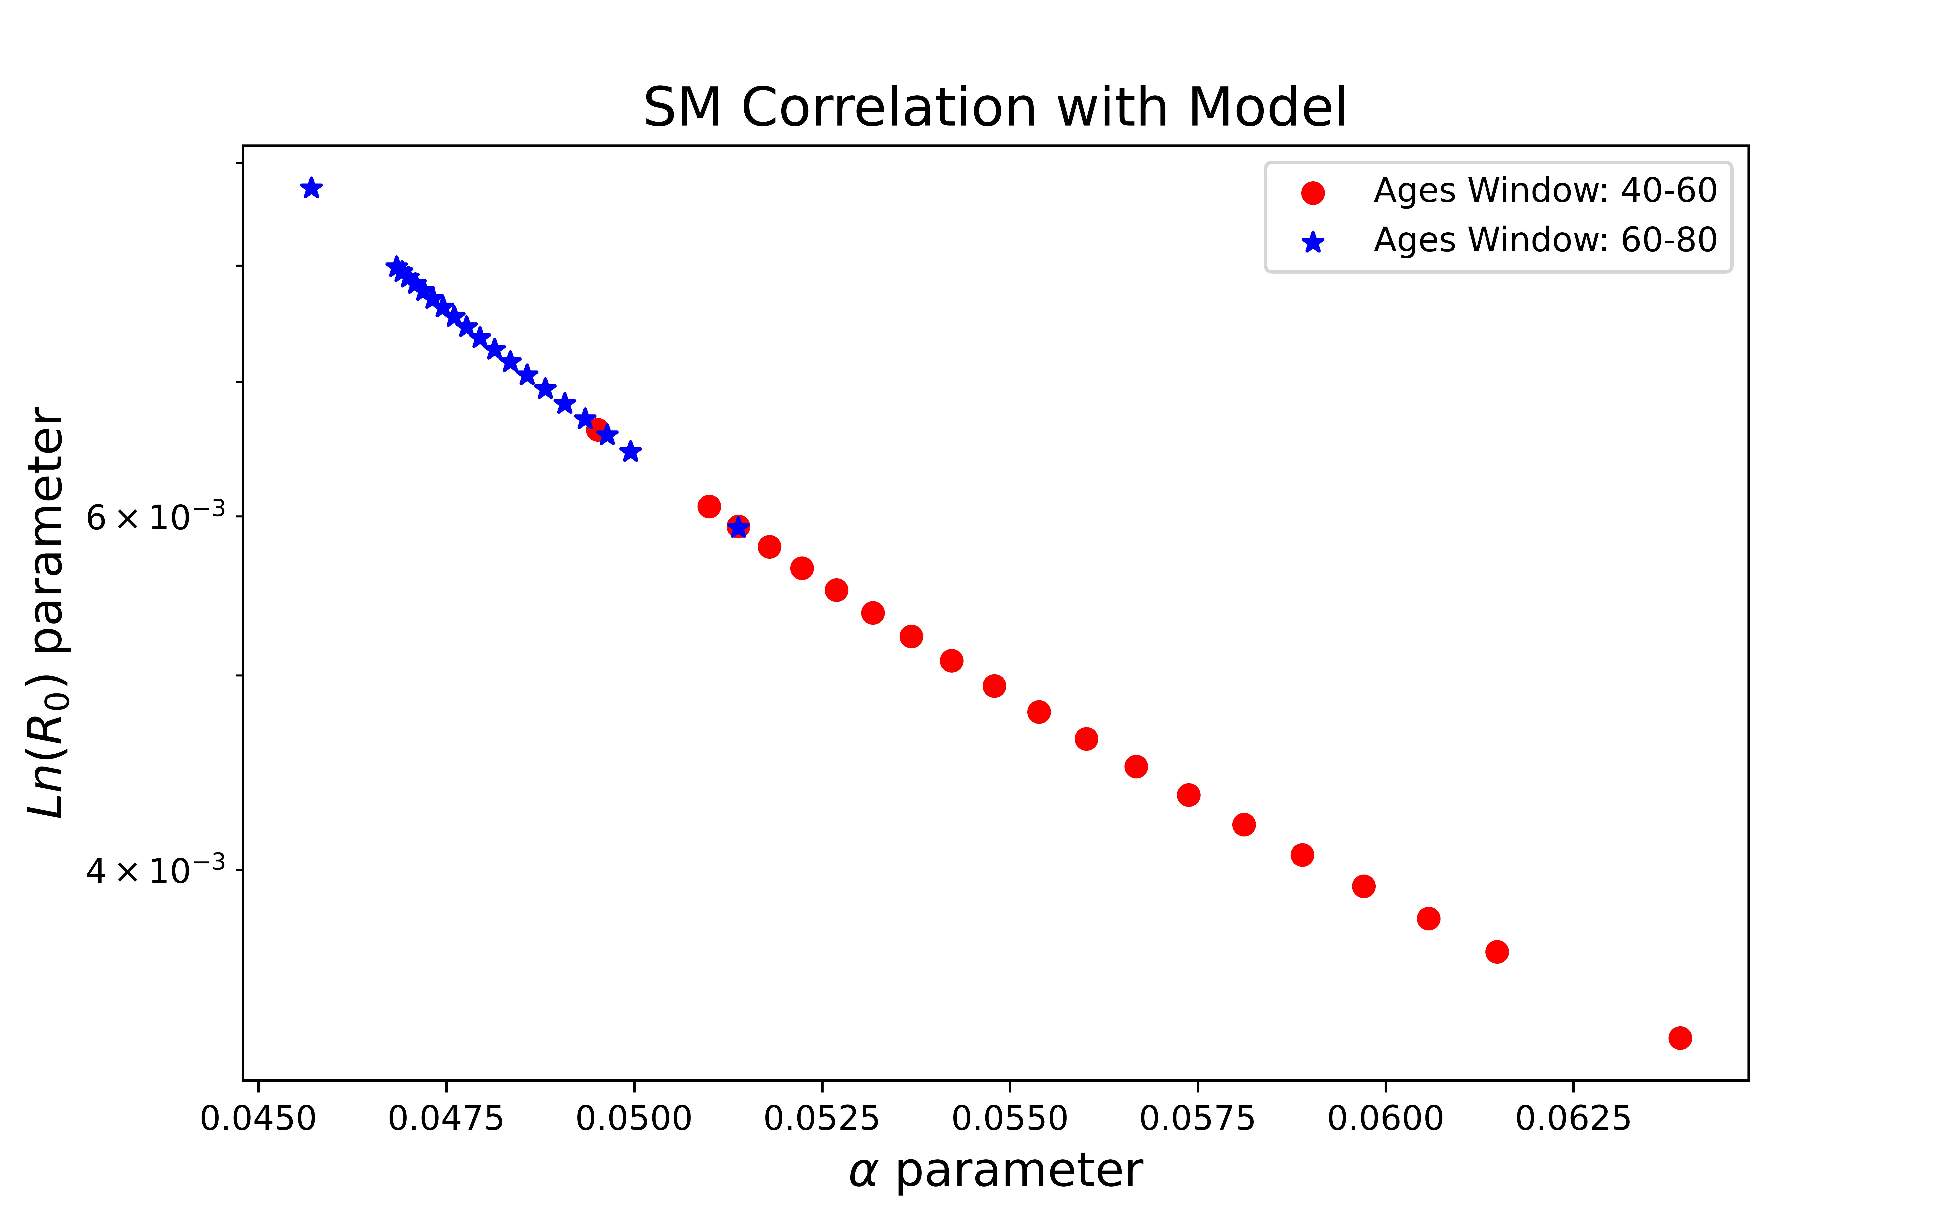
Model results for SM correlation
Slide XXX

Slide 35
Model results for SM correlation
Slide XXX

Slide 36
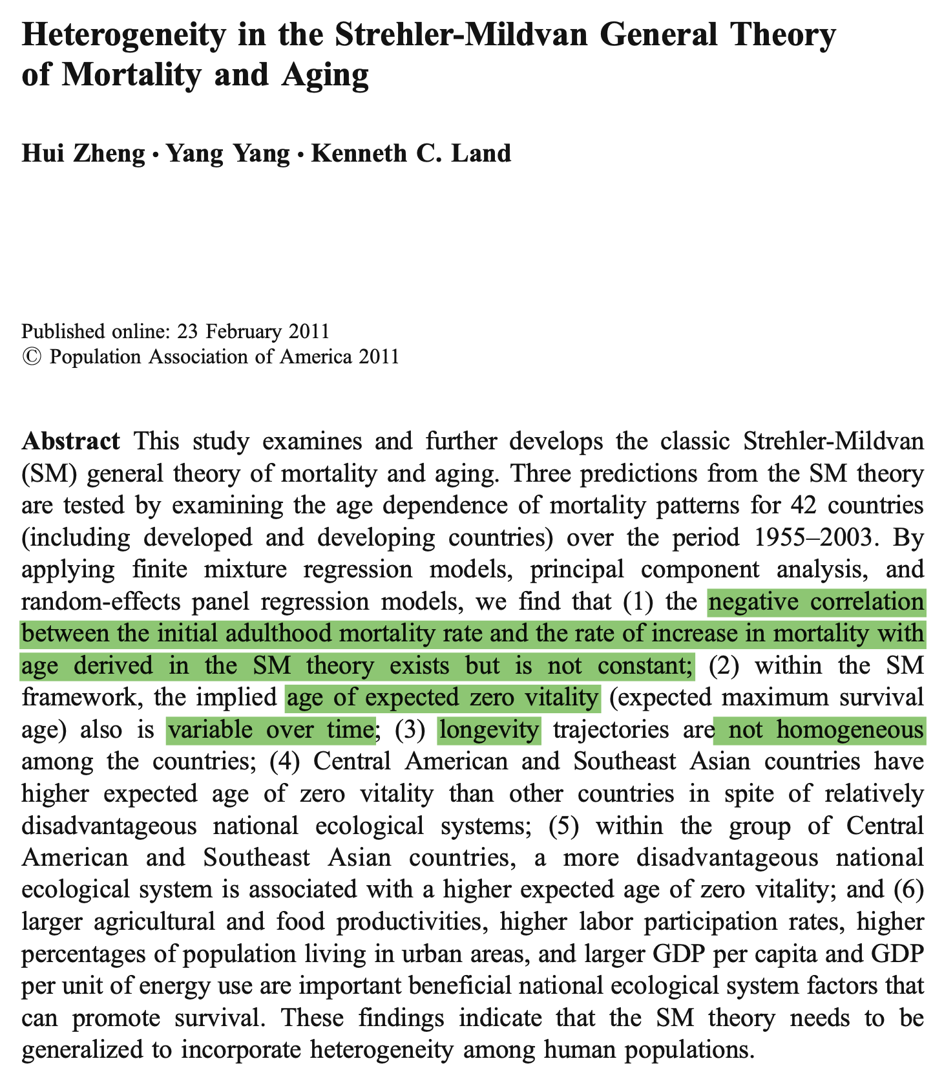
Literature Review
1. Are the initial mortality rate lnR0 and rate of increase in mortality α negatively correlated across the 42 countries and the period 1955–2003?
Nov-20

Slide 37
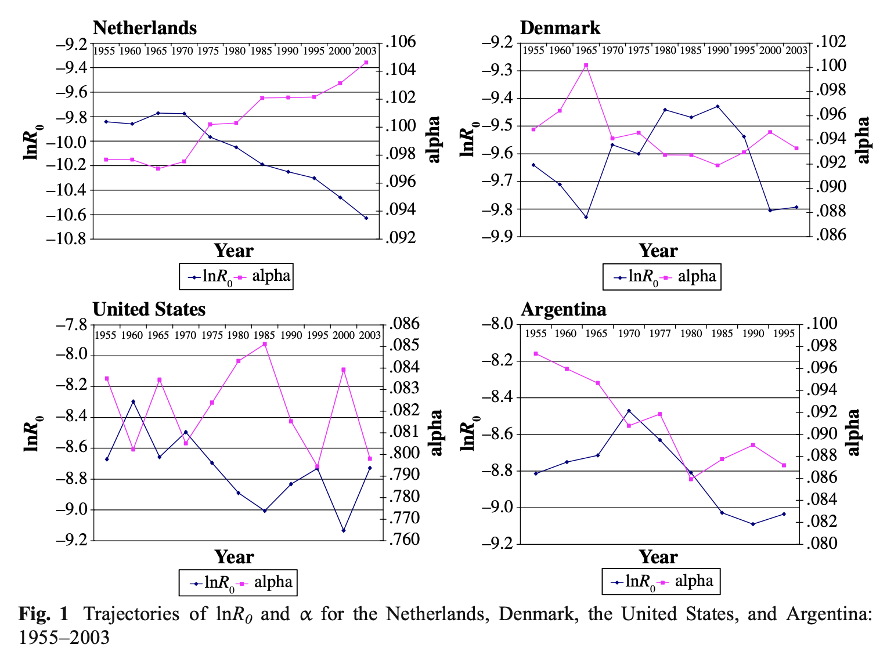
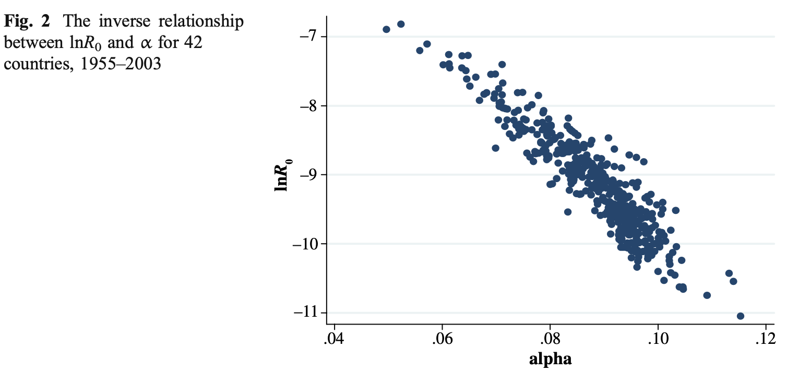
Literature Review
Nov-20

Slide 38
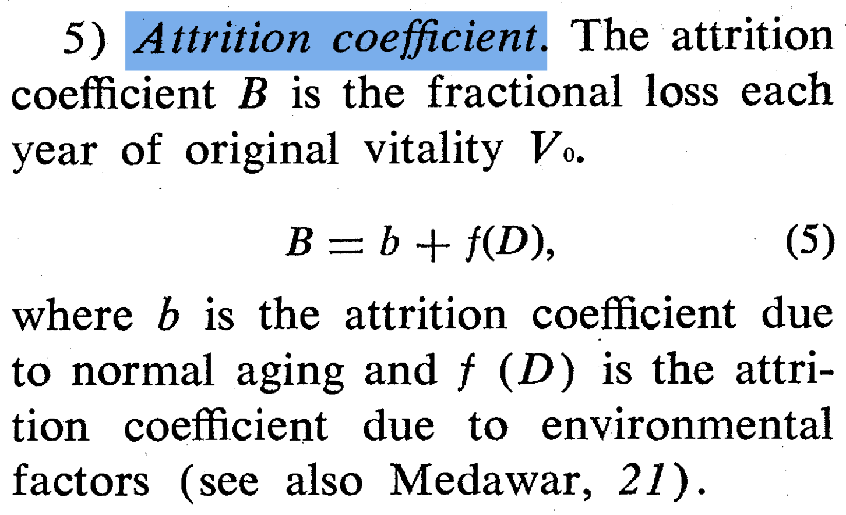
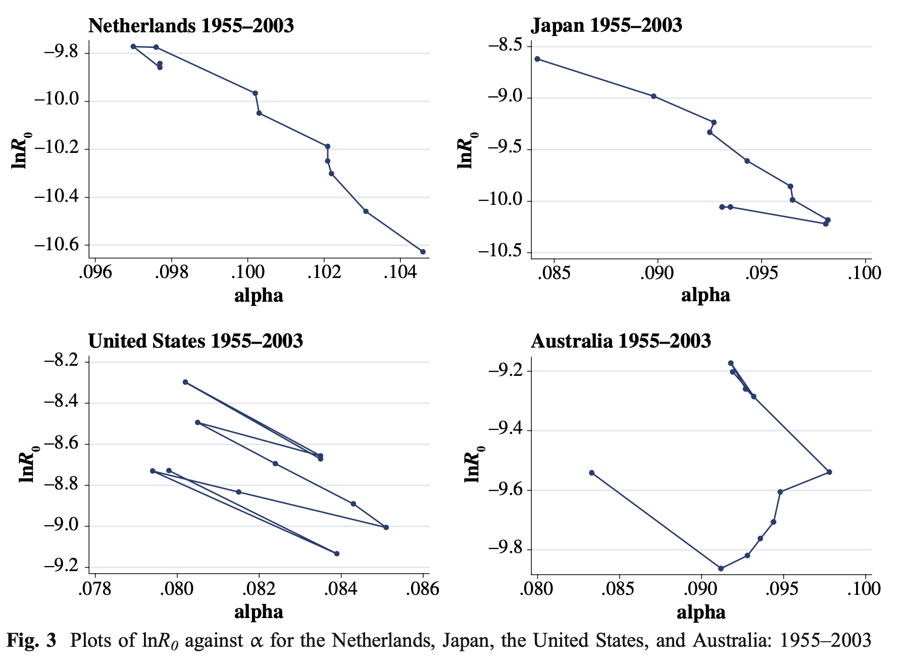
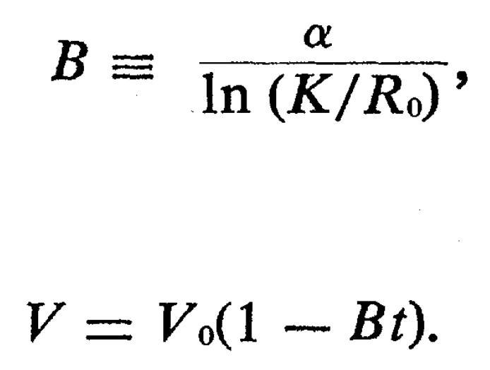
Literature Review
Is the fractional loss of vitality B constant—that is, is it dominated by normal aging process b and independent of the ecological system f (D)?
Take from the original paper of SM correlation
Nov-20

Slide 39
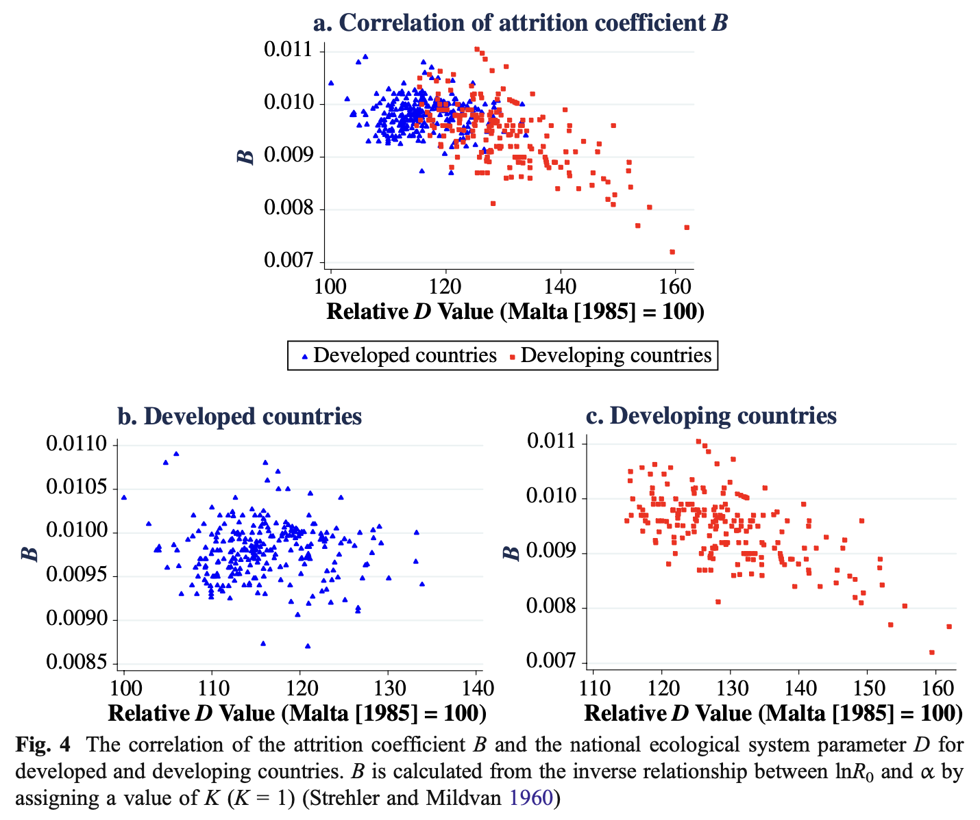
Literature Review
Have a nearly constant slope over the roughly 50-year period (e.g., the Netherlands and Greece).
Some patterns have typical “hooks” corresponding to recent changes in survival (e.g., Japan and Norway)
Negative relationship between lnR0 and α, but the y-intercept decreases over time
Some patterns show very unstable slopes
Vitality attrition coefficient B is not constant either over years or across countries.
Why change?
Nov-20

Slide 40
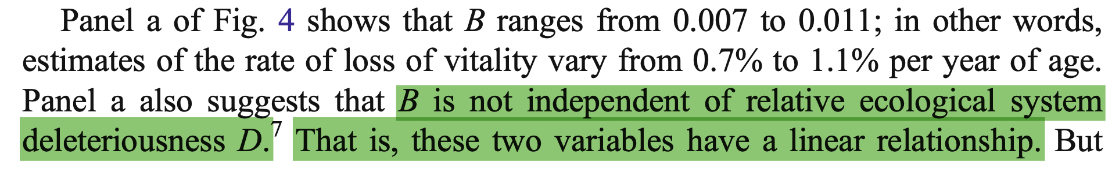
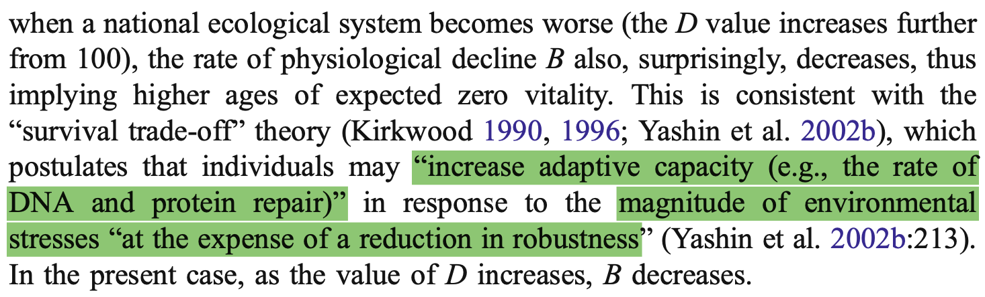
Literature Review
Why change?
In this context: Resilience increase and robustness decrease?
Nov-20

Slide 41
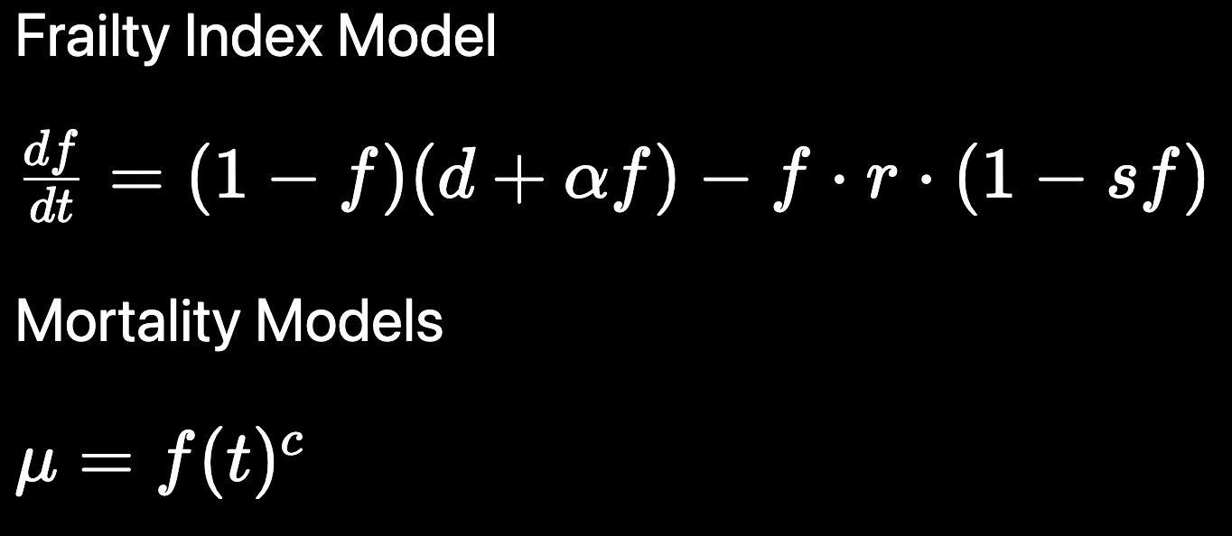


Model with implicit time
Don’t get the correct curvature of the frailty index
2. Don’t get a correct Strehler-Mildvan Correlation
Nov-20

Slide 42
Model with implicit time
2. No SM correlation is obtained.
Parameter alpha tends to zero
Don’t get the correct curvature of the frailty index
Problems with the Second derivative test?
Maybe because of the linearity of the function?
Nov-20

